Slide 1

Basic Details of the Team and Problem Statement
Ministry/Organization Name/Student Innovation:
Ministry of Culture
PS Code:
GM745
Problem Statement Title:
OCR and Fastest Scanning Device and Application
Team Name:
Squad Titans
Team Leader Name:
Jegadesh Muthu B
Institute Code (AISHE):
3124
Institute Name:
St Joseph's Institute of technology
Theme Name:
Smart Automation

Slide 2
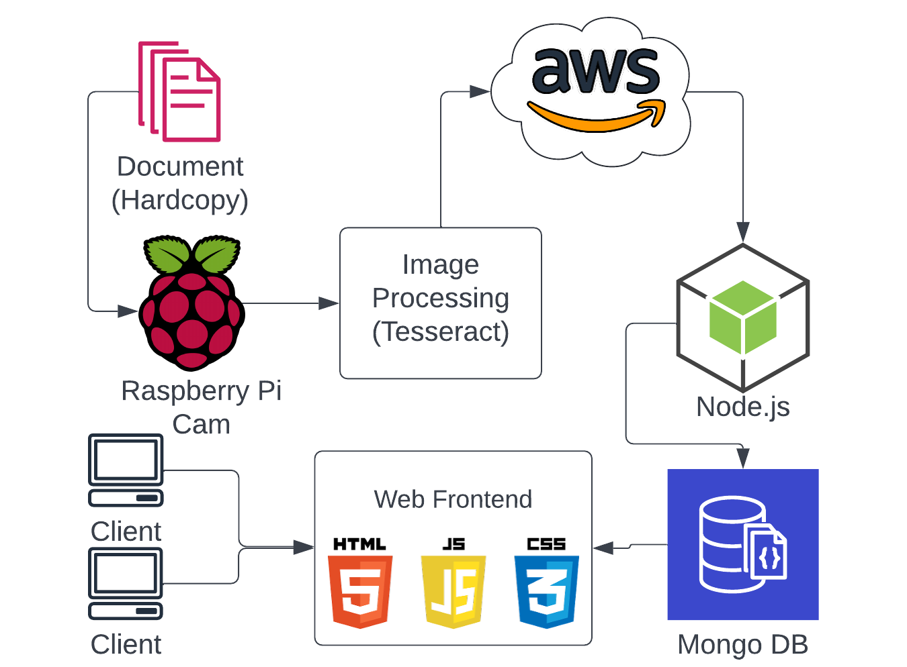
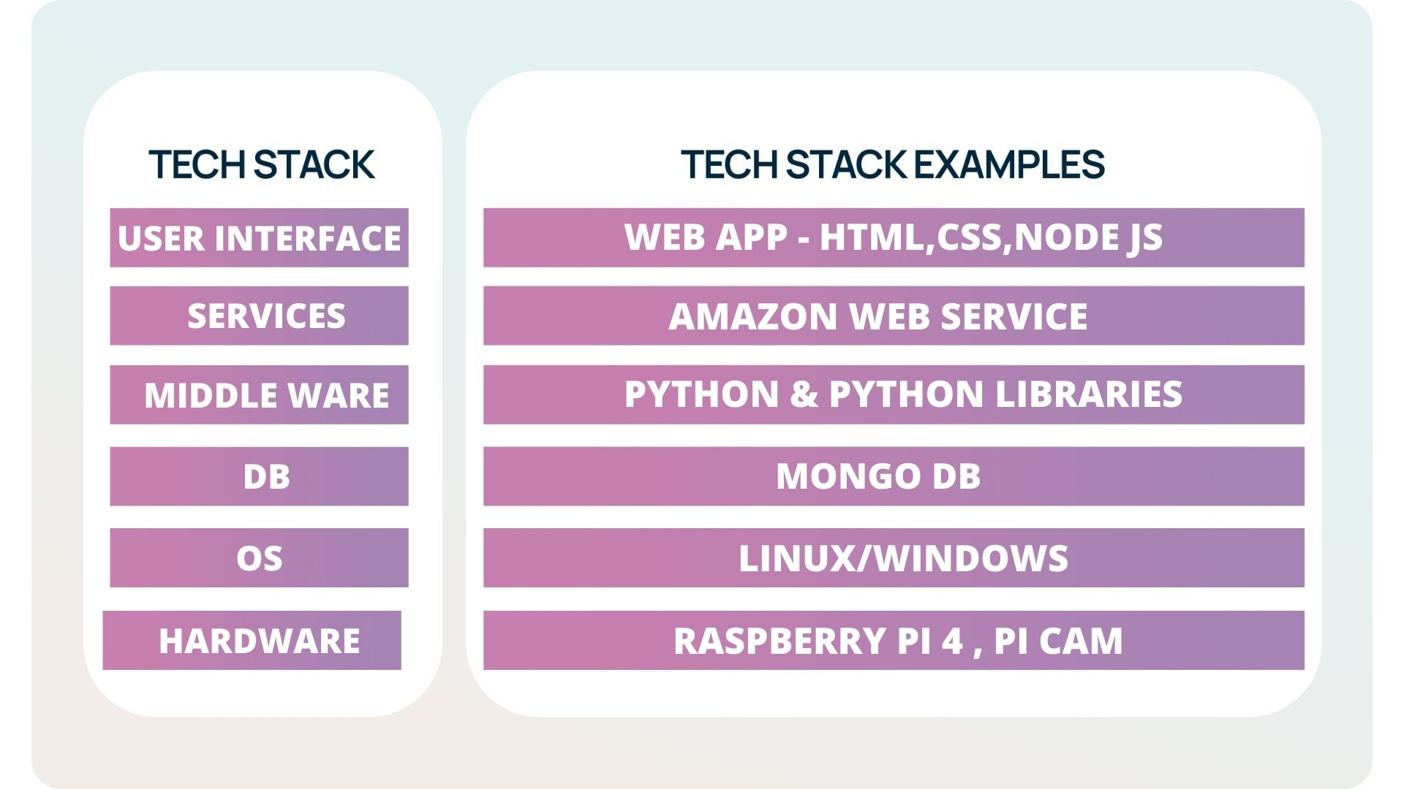
Idea/Approach Details
Idea/Solution:
IDEA: Big data document files are to be scanned using OCR(Optical Character Recognition) by handy hardware to carry documentation data to upcoming future generations, who can access it easily and efficiently.
SOLUTION: Using Raspberry pi 4 and pi cam as the hardware to scan the document using OCR(Optical Character Recognition), many OCRs will let you extract text from images on any device. All you need is a Portable Device we provide to start scanning the images to a text document. We have tried many online OCR tools But those OCRs have less speed efficient, so we used Tesseract OCR which is one of the fastest OCRs gave the best results for all the images we used. The service is completely free and very easy to embed. We use an additional file to save data of physical documents to be saved in Database or other fastest data storing techniques, now we use DataBase files to query the elements given by the user, which leads to faster search results. And to display every detail we will create a software to access it and view it by external devices
PROCESS FLOW CHAT
TECHNOLOGY STACK

Slide 3
Idea/Approach Details
PROBLEM STATEMENT CASES:
DEPENDENCIES:
Preserving archival documents.
Efficient and easy search of documents
Fast digitalization of archival documents
Time efficiency
To safeguard the data for future generation
Government Sector Employees
Registration purposes
Schools and colleges
Sectors consuming big data documents
REAL TIME USE:
For Government to scan huge data files, access it and secure them for future generations

Slide 4
Team Member Details
Team Leader Name: Jegadesh Muthu B
Branch (Btech/Mtech/PhD etc): BE Stream (ECE, CSE etc): ECE Year (I,II,III,IV): II
Team Member 1 Name: Rahul John J
Branch (Btech/Mtech/PhD etc): BE Stream (ECE, CSE etc): ECE Year (I,II,III,IV): II
Team Member 2 Name: Mohan Raj
Branch (Btech/Mtech/PhD etc): BE Stream (ECE, CSE etc): ECE Year (I,II,III,IV): II
Team Member 3 Name: Nithin C
Branch (Btech/Mtech/PhD etc): BE Stream (ECE, CSE etc): ECE Year (I,II,III,IV): II
Team Member 4 Name: Fenin B S
Branch (Btech/Mtech/PhD etc): BE Stream (ECE, CSE etc): ECE Year (I,II,III,IV): II
Team Member 5 Name: Neghashree V
Branch (Btech/Mtech/PhD etc): BE Stream (ECE, CSE etc): ECE Year (I,II,III,IV): II
Team Mentor 1 Name: Dr.C. Gnana Kousalya
Category (Academic/Industry):Academic Expertise (AI/ML/Blockchain etc): AI/ML Domain Experience (in years): 25
Team Mentor 2 Name: Jemima havila Catherine
Category (Academic/Industry): Academic Expertise (AI/ML/Blockchain etc): ML Domain Experience (in years): 1

